Slide 1

TELECOM CHURN PREDICTION
Submitted By-
ABHINAV KUMAR (1629119)
SAUBHAGYA ASHISH (1629171)
SHUBHANGI GUPTA (1629176)
SRIPRIYA SRIVASTAVA (1629183)
SHEFALI PANDEY (1629191)

Slide 2
CONTENT
Introduction
Scope and Objectives
System Analysis and design
Dataset Description
Algorithms Used
Result
Observation
Conclusion

Slide 3
INTRODUCTION-
The telecommunication industry has a very tough competition with the fellow competitors in order to retain their customers,and has thus become one of the research field in machine learning. Acquisition and the retention of customers are the top most concerns in today's business world.
Telecom Churn prediction helps in identifying those customers who are likely to leave a company. Telecommunication is coping with the issue of ever increasing churn rate. The major aim of churn prediction model is to identify such customers so that the retention strategies could be targeted upon them and the company may flourish by making its overall revenue.

Slide 4
Scope And Objectives-
The importance of this type of research is to help companies earn more profit. It can be applied with the following aim :-
To define and explain the related terms in churn prediction model.
To propose the novel framework that uses churn prediction in Data Handling.
To evaluate the techniques used in the churn prediction.
To determine the extent of Customer Churn.
To determine the causes of Customer Churn.
To examine the effects of Customer Churn on the telecom industry.
To find out features that can be utilized in order to build a predictive model for customer
churn in mobile telephony industry.

Slide 5
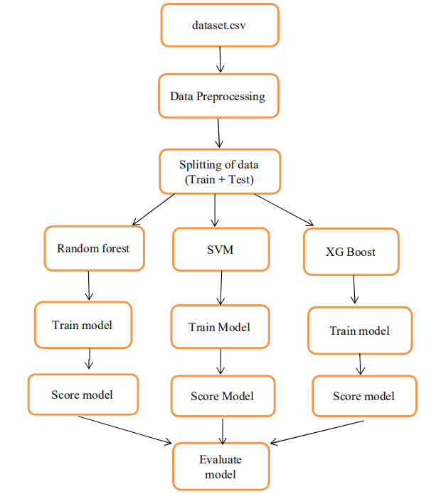
System Analysis and design-
#Train data- 60%, Test Data- 40%

Slide 6
Dataset Description-
The used dataset consists of 21 features for 7043 different customers. It consists of various features such as customer ID, gender, partner, dependents, tenure, phone service, multiple lines, internet service, online security, online backup, device protection, tech-support, streaming tv, streaming movies, contract, paperless billing, payment method, monthly charges, total charges and churn. There are three numerical features such as tenure, monthly charges and total charges. Rest of the features are Categorical i.e. paperless billing, streaming movies, payment method etc.

Slide 7
Algorithms Used-
Support Vector Machine - It is a supervised machine learning algorithm which can be used for both classification or regression challenges. However, it is mostly used in classification problems. In this algorithm, plotting of each data item takes place as a point in n-dimensional space (where n is number of features) with the value of each feature being the value of a particular coordinate. Then classification is performed by finding the hyper-plane that differentiate the two classes very well.

Slide 8
XGBoost- It is an open-source software library which provides a gradient boosting framework for C++, Java, Python, R, and Julia. It works on Linux, Windows, and macOS. From the project description, it aims to provide a "Scalable, Portable and Distributed Gradient Boosting Library.
Random Forest- Random forests or random decision forests are an ensemble learning method for classification, regression and other tasks that operates by constructing a multitude of decision trees at training time and outputting the class that is the mode of the classes or mean prediction of the individual trees.

Slide 9
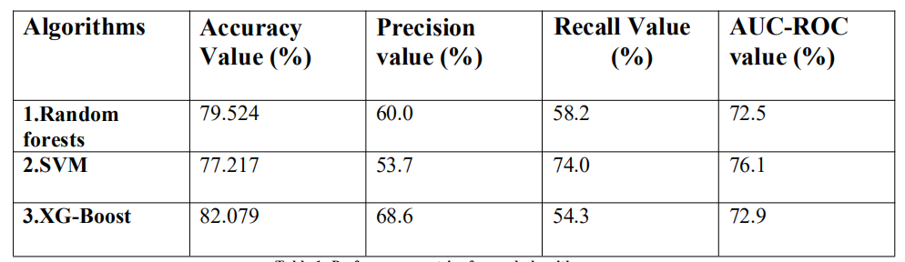
Results-

Slide 10
Observations-
In terms of Accuracy, XG-Boost performs the best and returns the best accuracy value of 82.079 %
In terms of Precision, XG-boost gave the best value for precision as well followed by random forests and SVM i.e. 68.6 %, 60 % and 53.7 % respectively.
In terms of Recall value, SVM gave the best value of recall followed by random forests and XG boost.
In terms of area under curve, SVM gave the best value followed by XG boost and random forests.

Slide 11
Conclusion
Churn prediction is a technique that involves systematic analysis of customer data for identifying and analyzing patterns and trends of customer loyalty and blend. The detected patterns and trends can be used by telecommunication industries to improve customer relationship and at the same time improve net profit. Identification of churners and non-churners is a time consuming and critical task, that has to be performed carefully, as the future growth of the company relies on the result of such an analysis. This task is considered challenging because of two reasons, (i) customer information volume has increased and (ii) the data available is inconsistent and are incomplete thus making the task of formal analysis

